Slide 2
Beam Shaping with Digital Mirror Devices(DMD)
Xiaoyu Jiang
2018/11/12

Slide 3
Motivation: We want to address individual atoms in our qubit array
Current Scheme: Single site addressing is performed with a 2D AOM scanner.
Use holography for addressing: To achieve multiple site addressing simultaneously.
DMD: Fast frame rate( 19kHz)

Slide 4
Overview of the talk:
Quick review of Fourier optics and Holography
Brief introduction to DMD
My current work

Slide 5
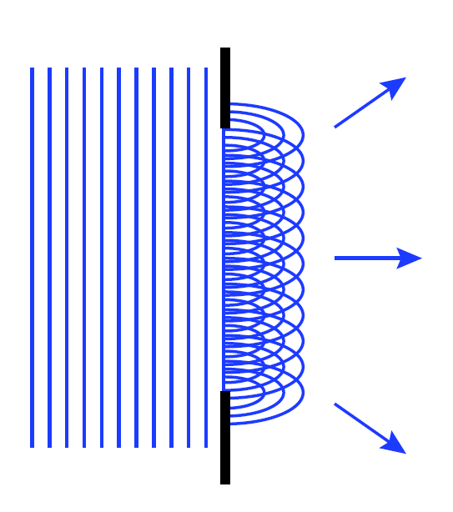
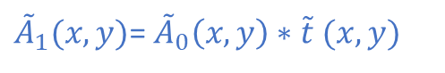
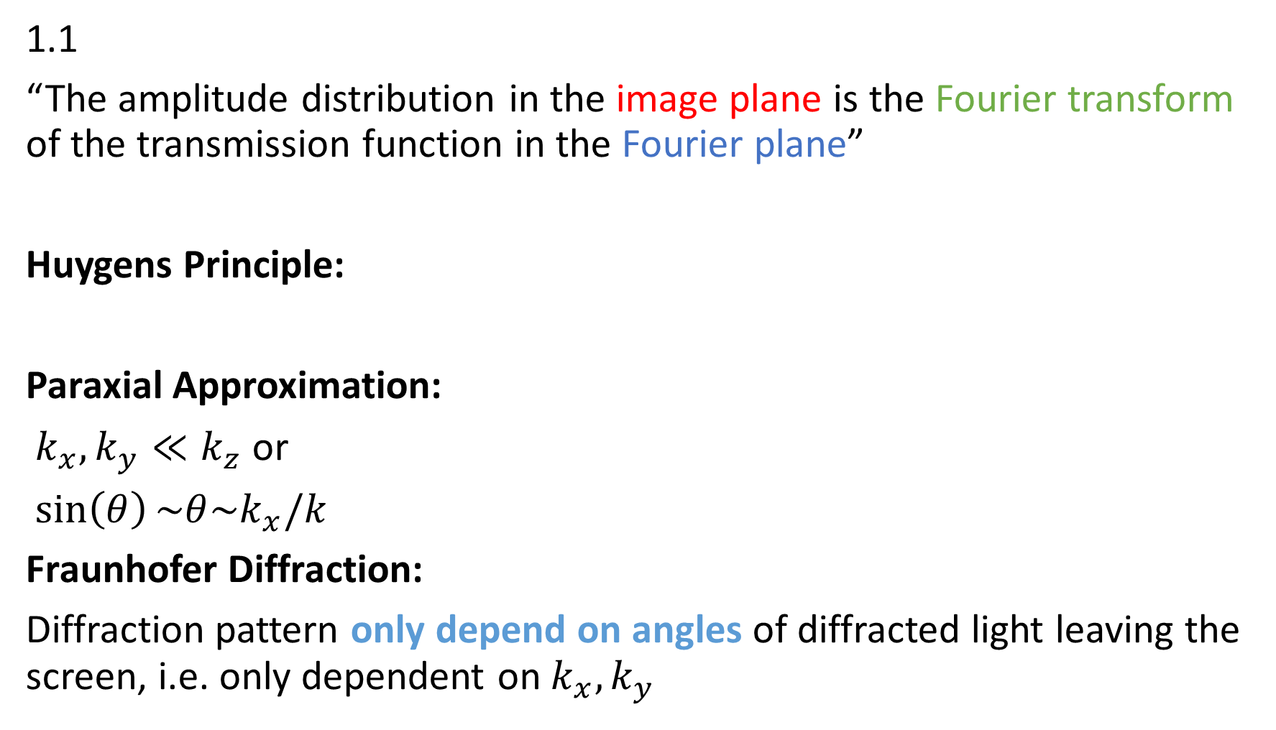
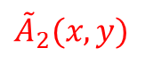
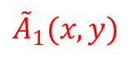
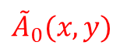
1.1
“The amplitude distribution in the image plane is the Fourier transform of the transmission function in the Fourier plane”
Huygens Principle:
Paraxial Approximation:
$k_{x},k_{y}≪k_{z}$ or
$\sin\left(θ\right)\sim θ\sim k_{x}/k$
Fraunhofer Diffraction:
Diffraction pattern only depend on angles of diffracted light leaving the screen, i.e. only dependent on $k_{x},k_{y}$
P
$${\tilde{A}}_{0}(x,y)$$
$${\tilde{A}}_{1}(x,y)$$
$${\tilde{A}}_{2}(x,y)$$
${\tilde{A}}_{1}(x,y)$= ${\tilde{A}}_{0}\left(x,y\right)∗\tilde{t} (x,y)$
z

Slide 6
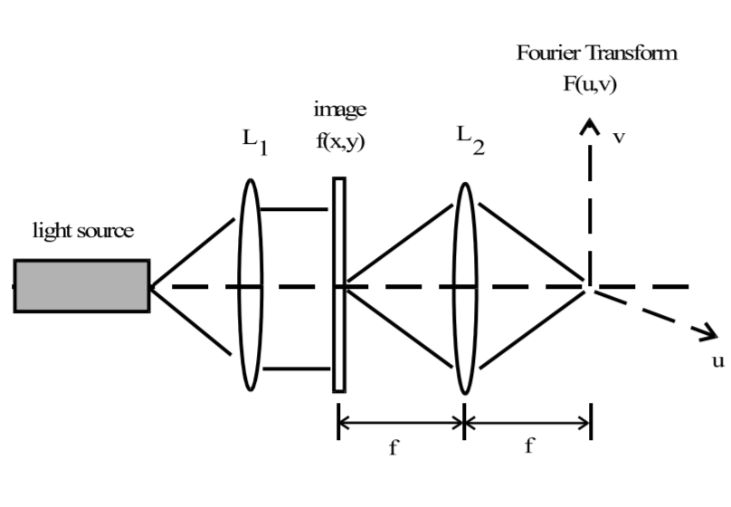
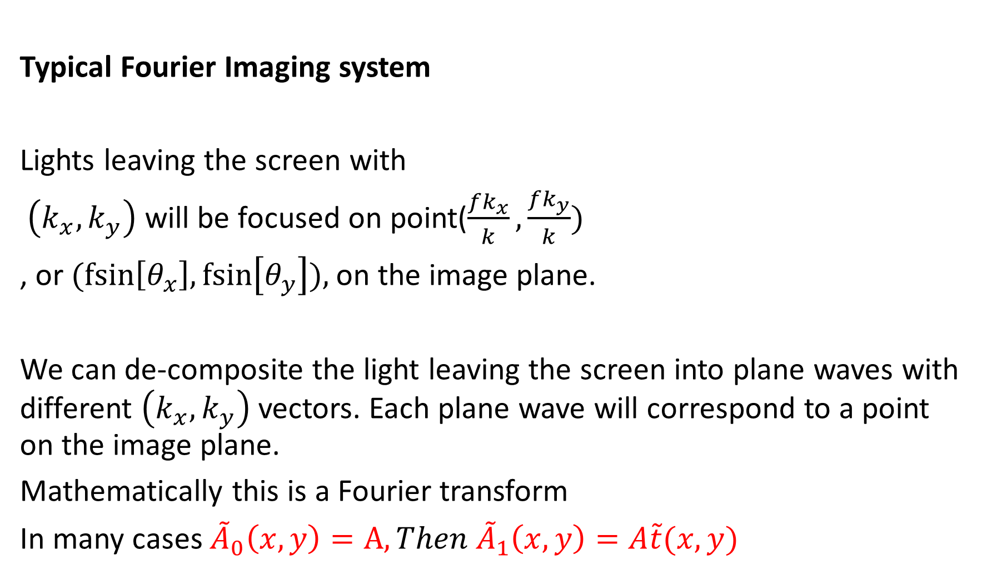
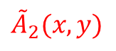
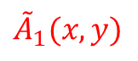
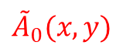
Typical Fourier Imaging system
Lights leaving the screen with
$\left(k_{x},k_{y}\right)$ will be focused on point($\frac{fk_{x}}{k},\frac{fk_{y}}{k})$
, or $(fsin\left[θ_{x}\right],fsin\left[θ_{y}\right]),$on the image plane.
We can de-composite the light leaving the screen into plane waves with different $\left(k_{x},k_{y}\right)$ vectors. Each plane wave will correspond to a point on the image plane.
Mathematically this is a Fourier transform
In many cases ${\tilde{A}}_{0}\left(x,y\right)=A,Then {\tilde{A}}_{1}\left(x,y\right)=A\tilde{t}(x,y)$
screen
$${\tilde{A}}_{0}(x,y)$$
$${\tilde{A}}_{1}(x,y)$$
$${\tilde{A}}_{2}(x,y)$$
Spatial filtering
Fraun. Diffraction/
Fourier Transform

Slide 7
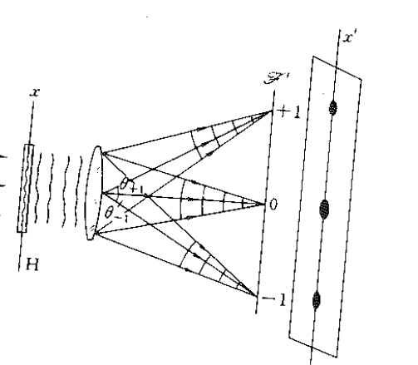
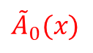
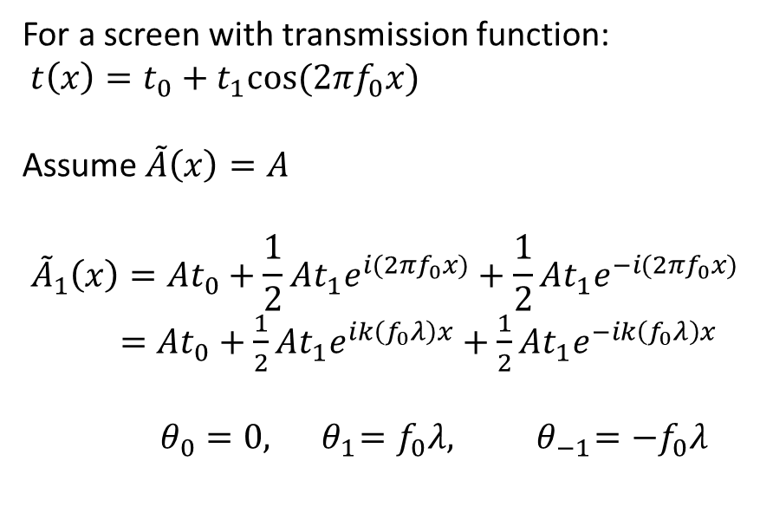
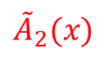
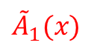
Example: Cosine grating
For a screen with transmission function:
$t\left(x\right)=t_{0}+t_{1}cos⁡(2πf_{0}x)$
Assume $\tilde{A}\left(x\right)=A$
$${\tilde{A}}_{1}\left(x\right)=At_{0}+\frac{1}{2}At_{1}e^{i(2πf_{0}x)}+\frac{1}{2}At_{1}e^{−i(2πf_{0}x)}$$
$=At_{0}+\frac{1}{2}At_{1}e^{ik\left(f_{0}λ\right)x}+\frac{1}{2}At_{1}e^{−ik\left(f_{0}λ\right)x}$
$θ_{0}=0, { θ}_{1}=f_{0}λ, { θ}_{−1}=−f_{0}λ$
$${\tilde{A}}_{0}(x)$$
$${\tilde{A}}_{1}(x)$$
$${\tilde{A}}_{2}(x)$$

Slide 8
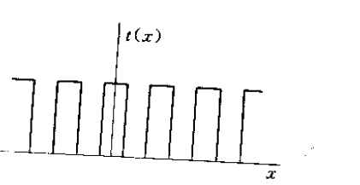
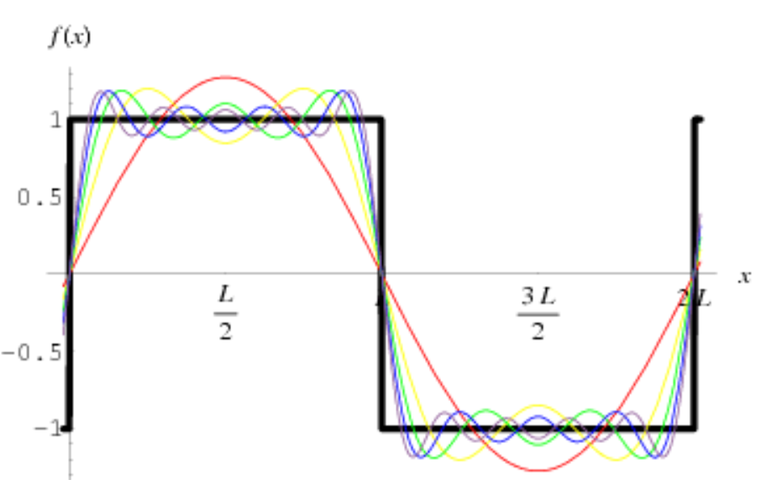
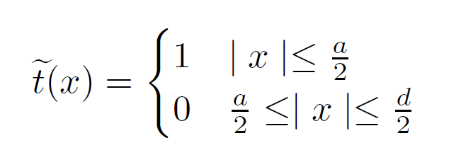
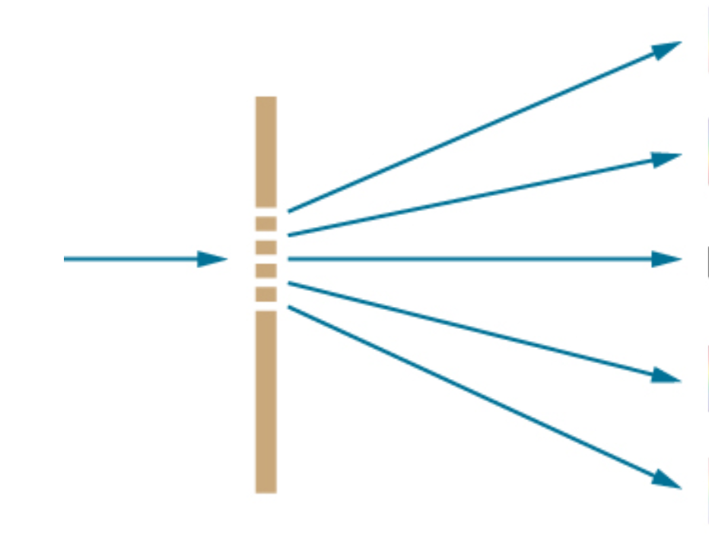
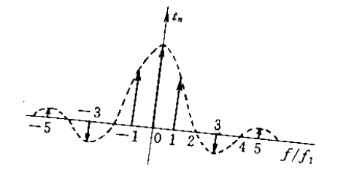
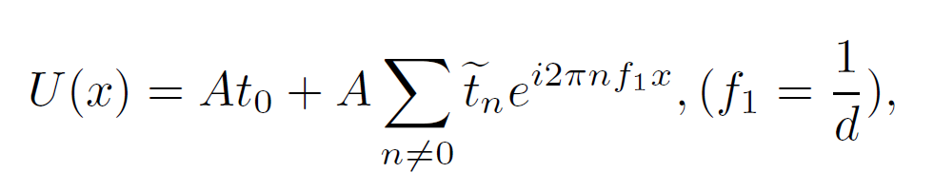
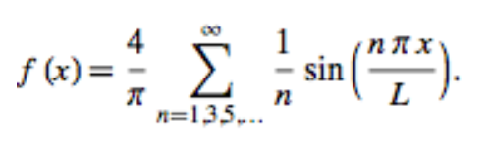
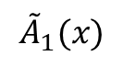
Analogy between FTs in optics and electronics
Square Wave:
Diffraction grating
A
U(x)
$${\tilde{A}}_{1}(x)$$

Slide 9
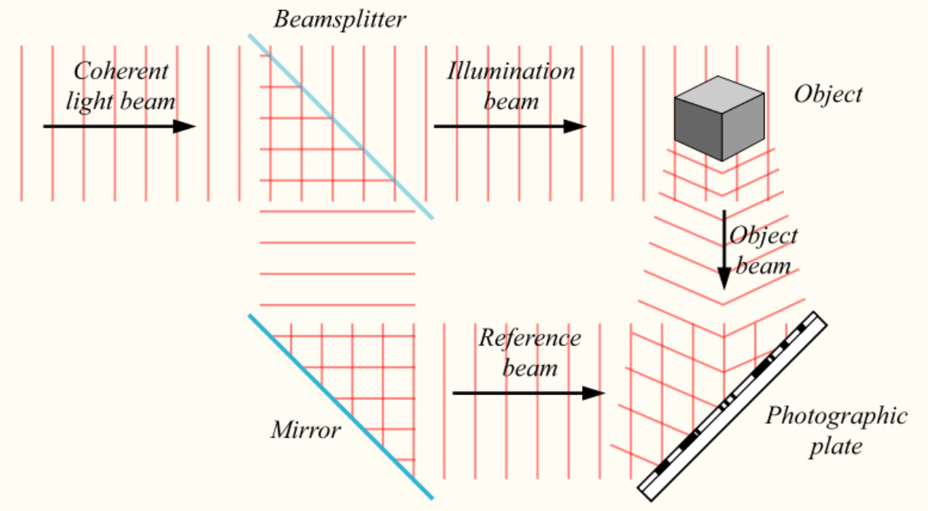
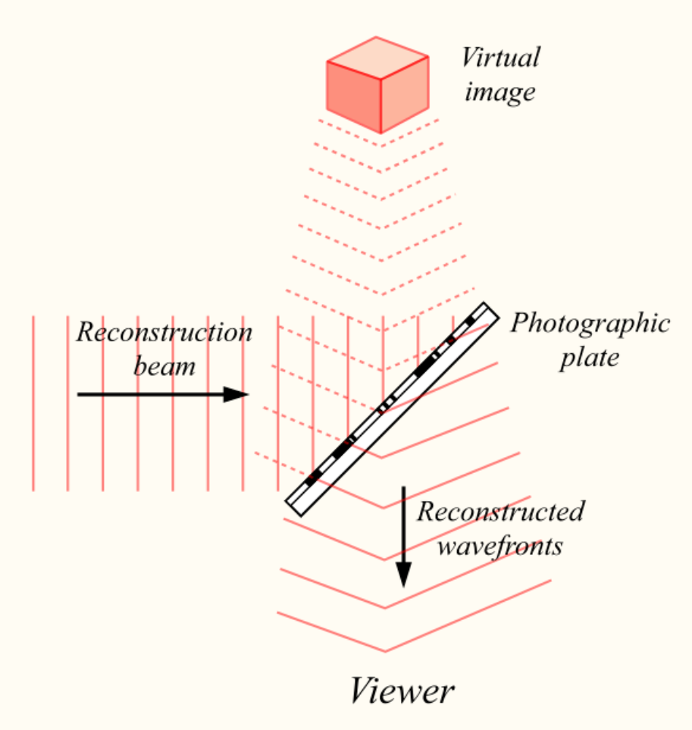
1.2 Holography:
used to display a fully
three-dimensional
image of the subject
2 steps
1
Computer Generated Hologram
2

Slide 10
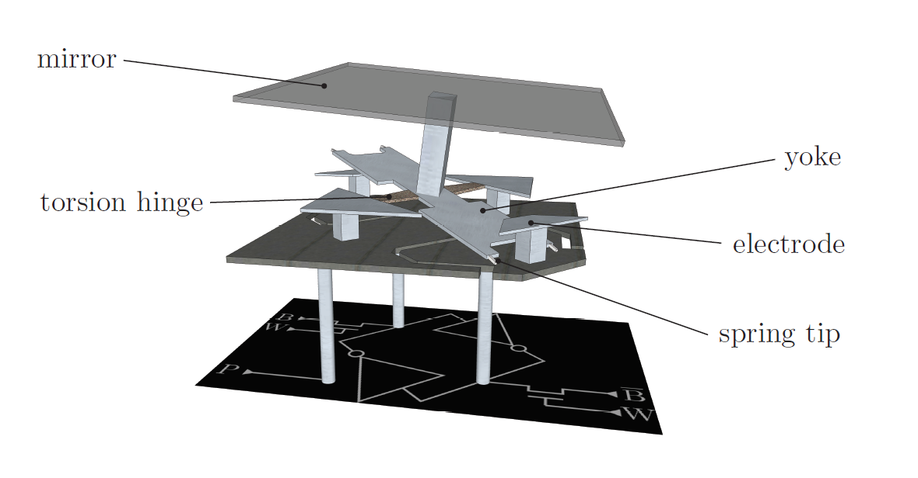
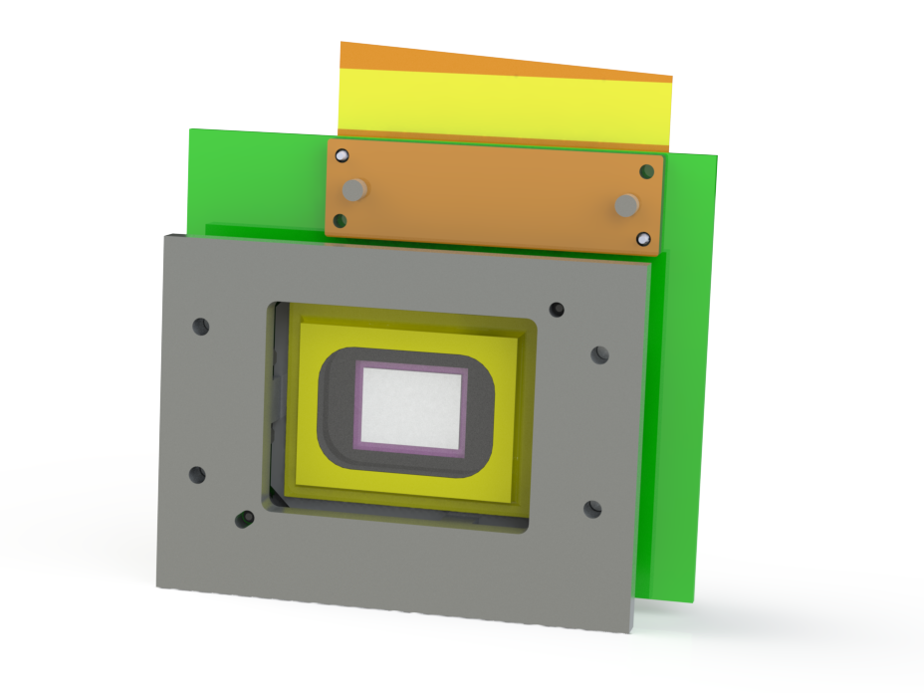
2.1 DMD: Introduction
A array of mirrors that each pixel has two states:
Frame Rate: ~19kHz
Pixel Number: 1024*768
12°
12°

Slide 11

2.2 DMD in the image plane
Not efficient
To dynamically address a single site from an array of N sites, the efficiency is 1/N
2. Not able to fix aberrations
Use DMD in the Fourier plane
DMD
Atomic Array

Slide 12
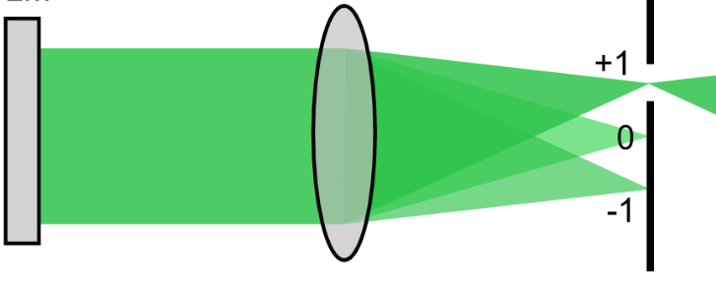
2.3 Limits of DMD in the Fourier plane:
Amplitude hologram: Use +1 order in the diffraction pattern
(Each frequency component interfere constructively at 0th order)
Binary Hologram: Lose details
Efficiency: Theoretical limit 10%
Image Plane
DMD

Slide 13
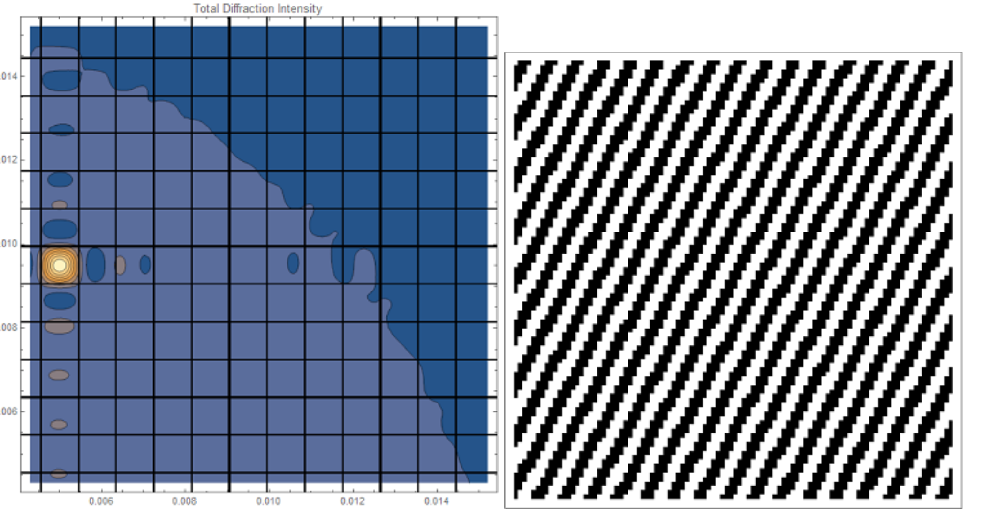
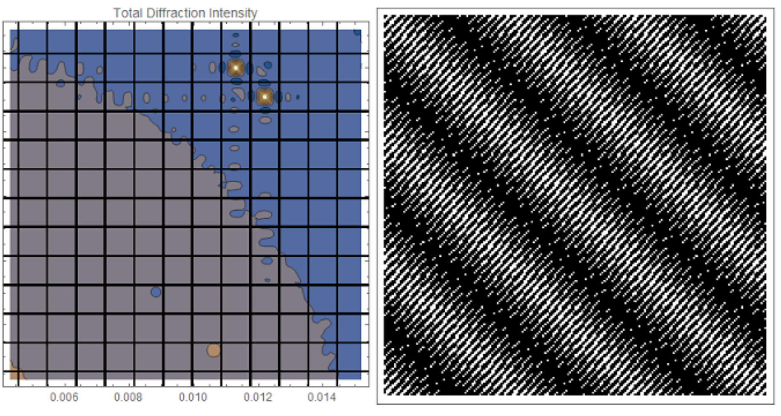
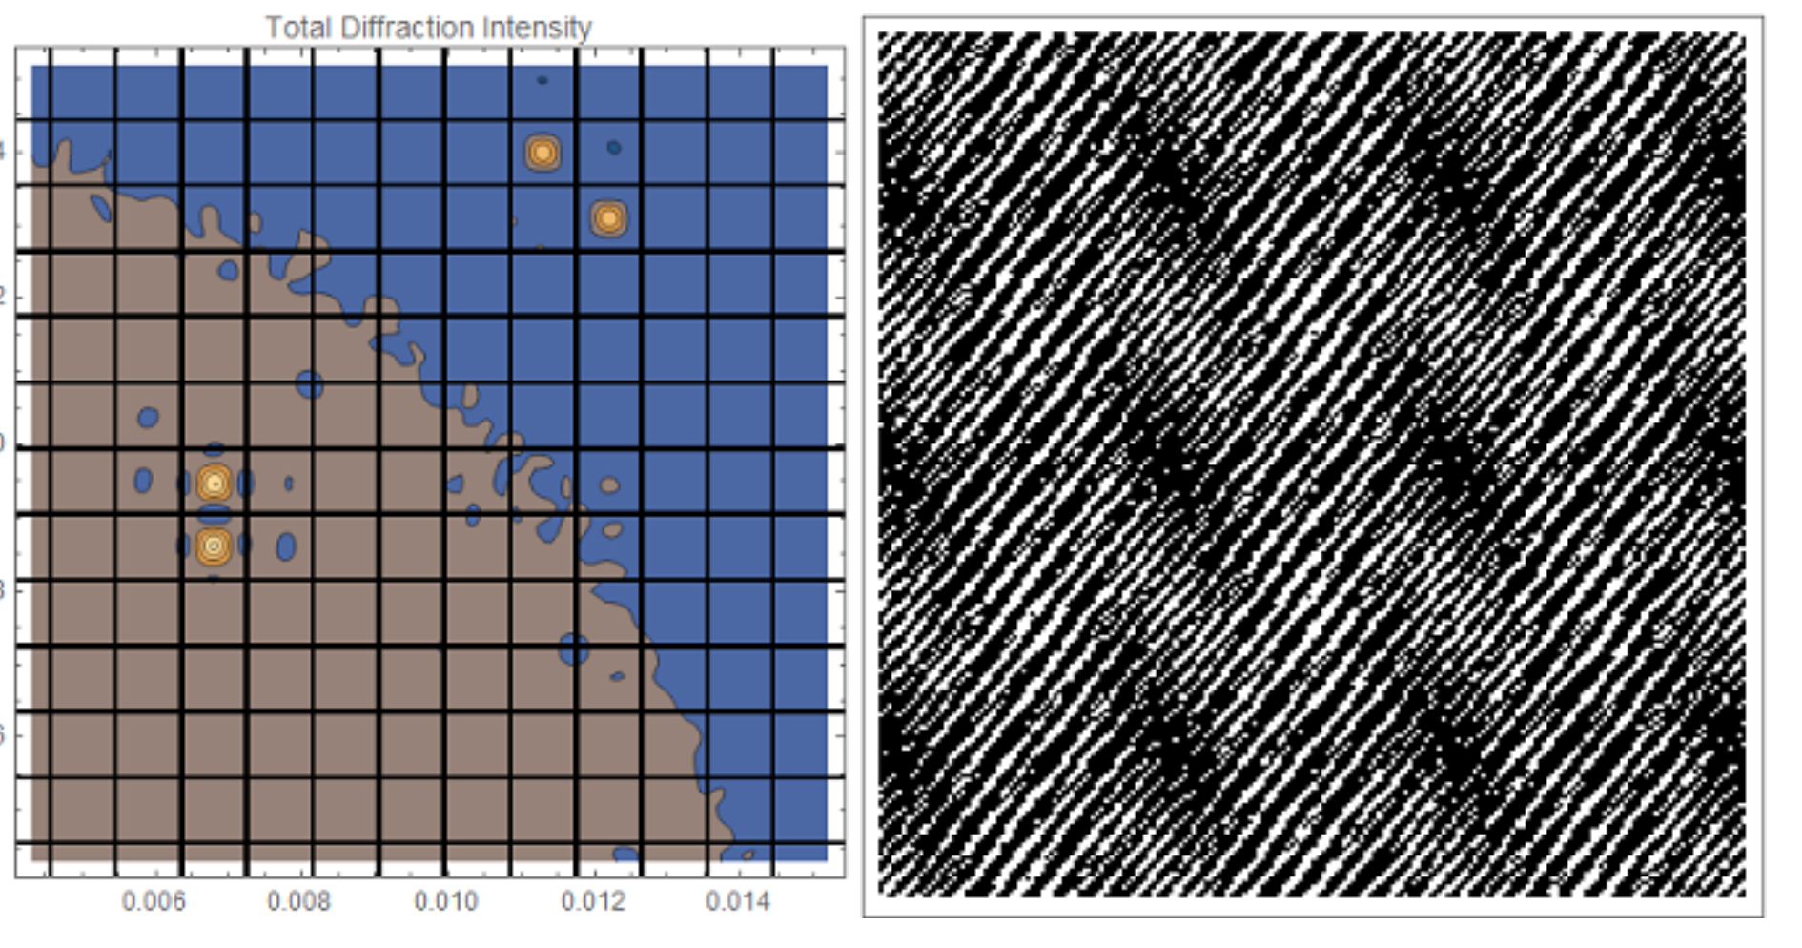
3.1 Addressing arbitrary points
in the image plane
Algorithm: simply checking the contribution from each mirror pixel to the target image, set up a cut-off threshold.

Slide 14
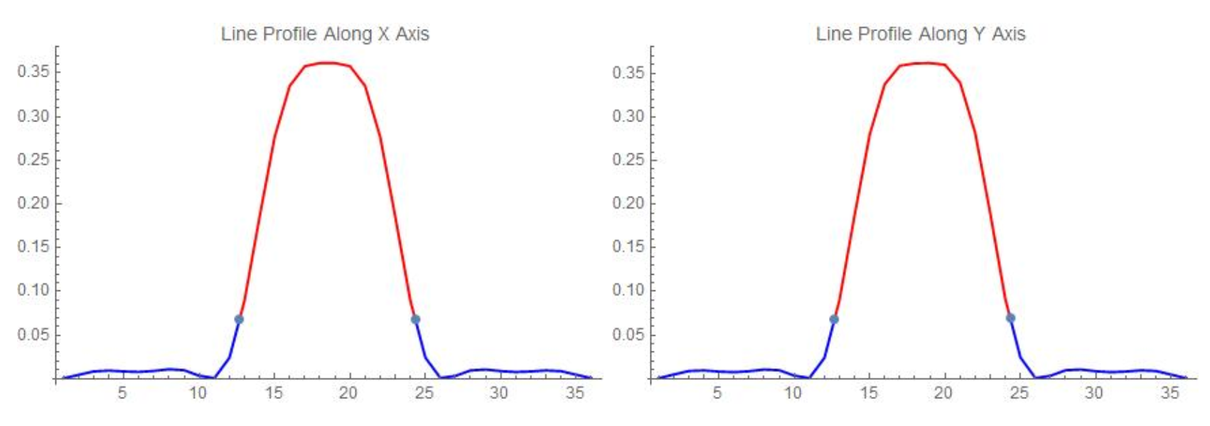
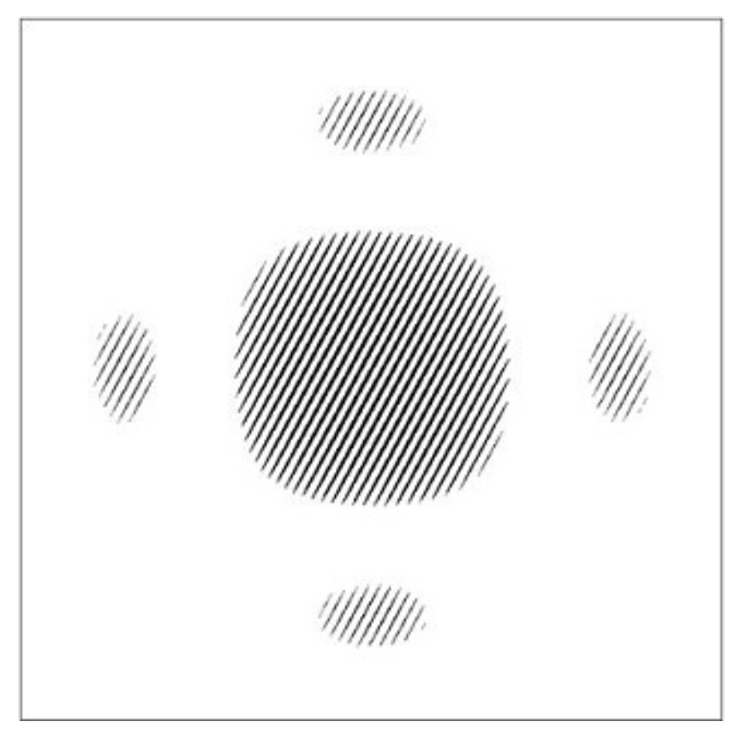
3.2 Generating Flat-top beams in the target site
Brute approximation to binary values
Iterative method
Noise level: 3%

Slide 15
Dithering Algorithm:
Summary of the current dithering algorithm I'm using:
(1) Set the "target" image, which is the beam profile we want at the atom arrays.
(2) Do an inverse Fourier transform on the target image to get the corresponding hologram. The value of each pixel of the hologram H(x,y) is a complex number.
(3) Take the real value of each hologram pixel.
(4) Set up a cut-off constant C1(0<C1<1, usually around 10^(-3)), divide the hologram pixels into two separate sets and do the following operation:
Set A: Abs[H(x,y)]<C1. Set all pixels in this set to 0(off). Set B: Abs[H(x,y)]>C1. Normalize the values of pixels in this set to range[0,1].
(5) Set up a cut-off constant C2(0<C2<1), divide the hologram pixels into two separate sets and do the following operation:
Set B1: H(x,y)>C2. Set all pixels in this set to 1(on). Set B2: H(x,y)<C2. Re-assign the values of pixels in this set in a probabilistic way: H'(x,y)~Bernoulli[C3*H(x,y)]. C3 is a constant. H'(x,y) is the newly assigned value. H(x,y) is the original value of this pixel with range[0, C2).
(6) We now have the hologram generated. Do a Fourier transform of the hologram to get the corresponding image.

Slide 16
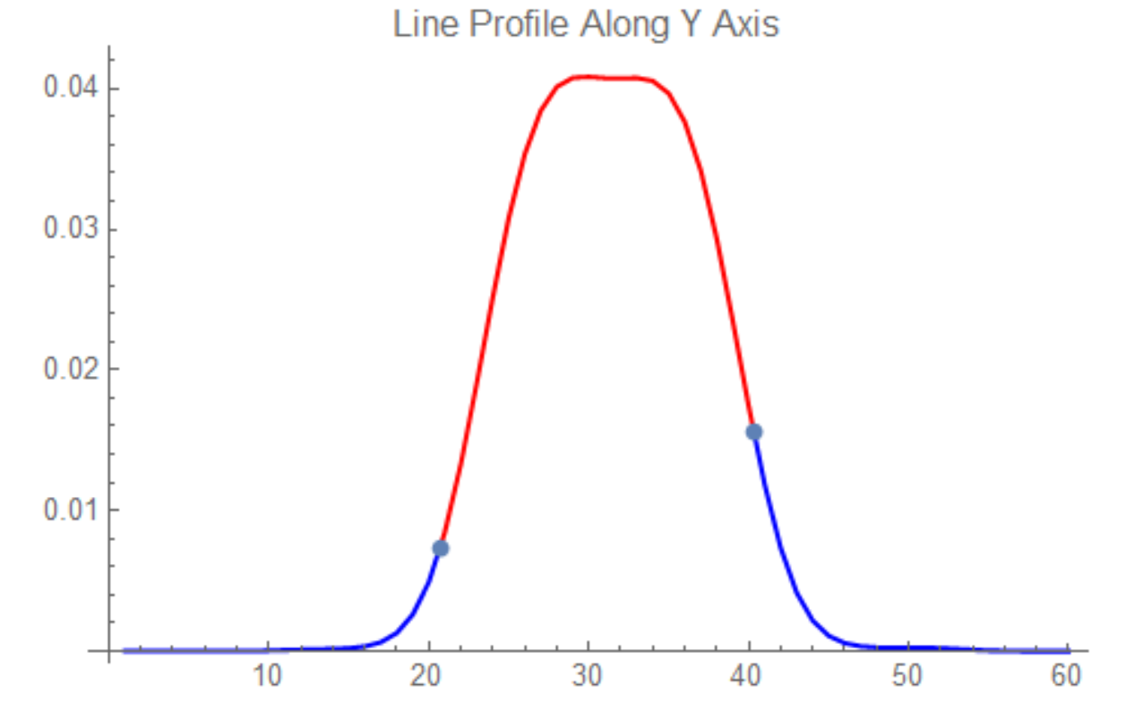
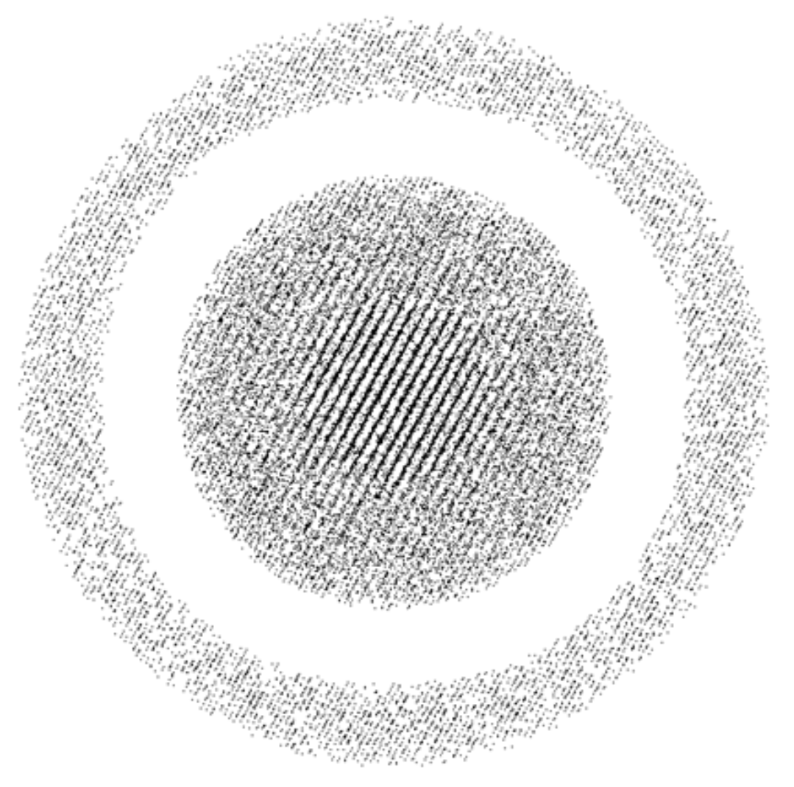
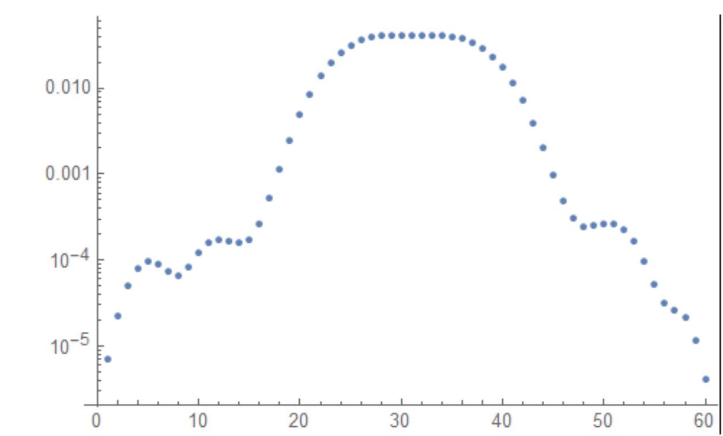
Dithering Algorithm
Noise level of 0.1%

Slide 17
Concerns: Low filling factor reduces efficiency
Solution: Use a diffractive element in front of the DMD to increase filling
Energy efficiency: 3.5%
Diffractive Element
DMD

Slide 18
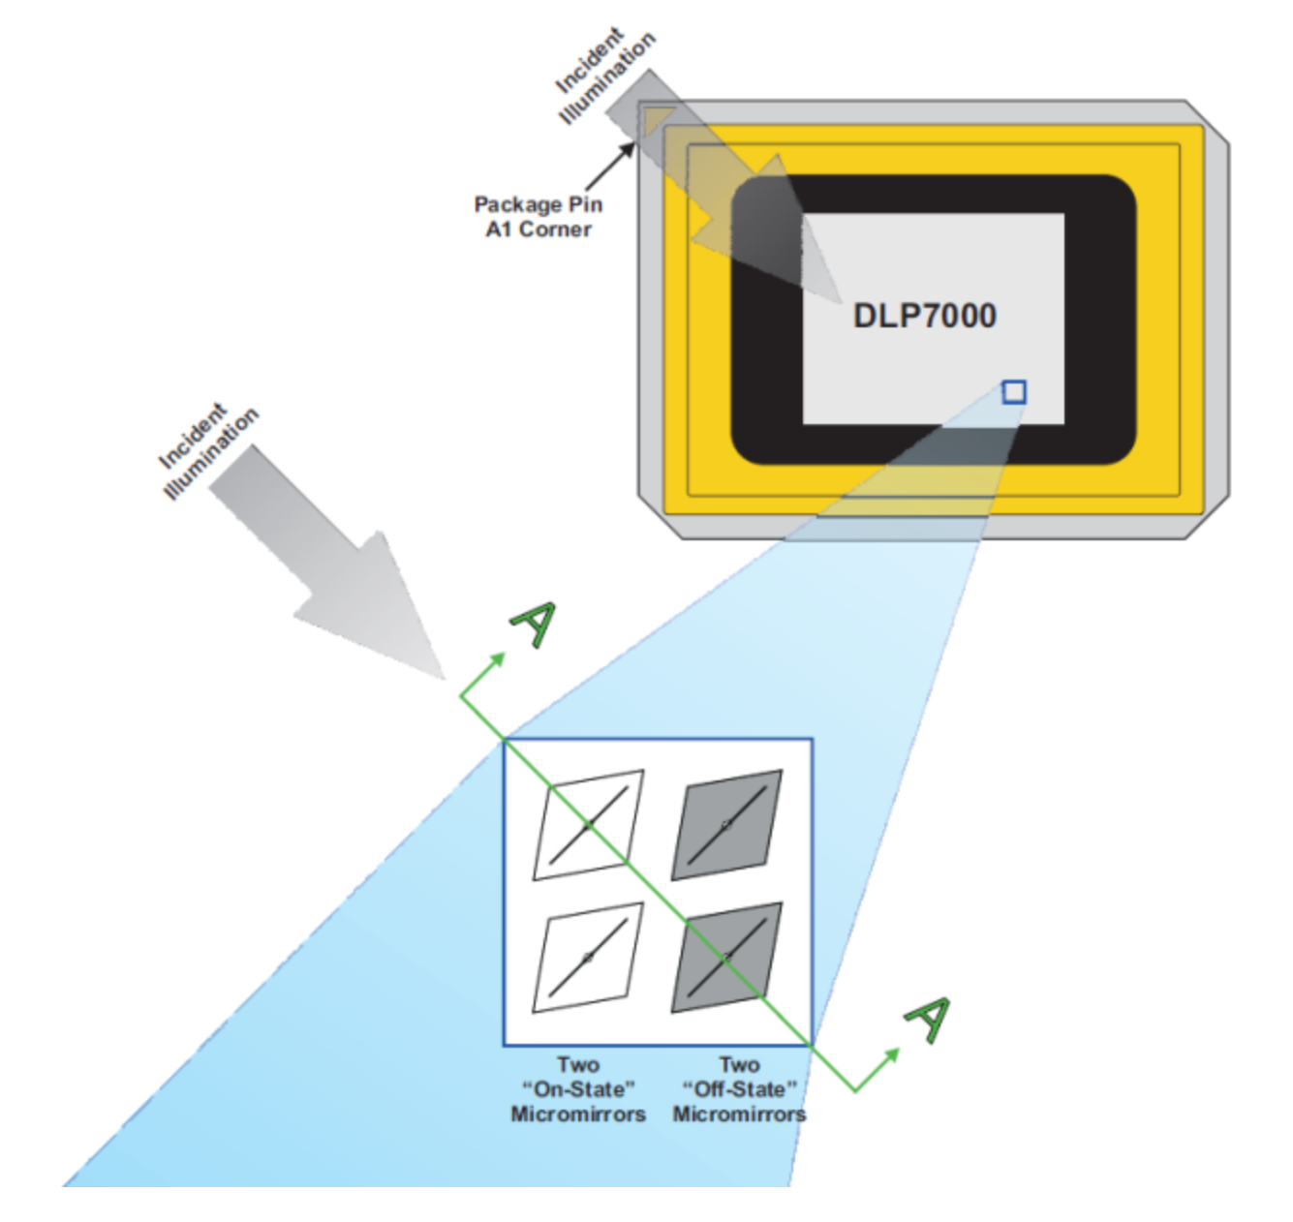
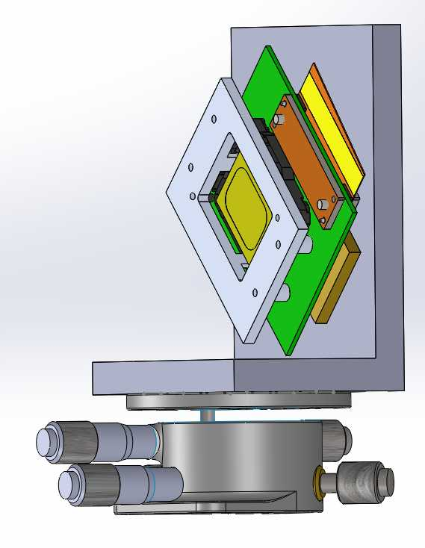
Current work: setting up a test system.

